Slide 1

“Team 1”
Analysts:
Andy
Marianna
Reuben
Carla

Slide 2
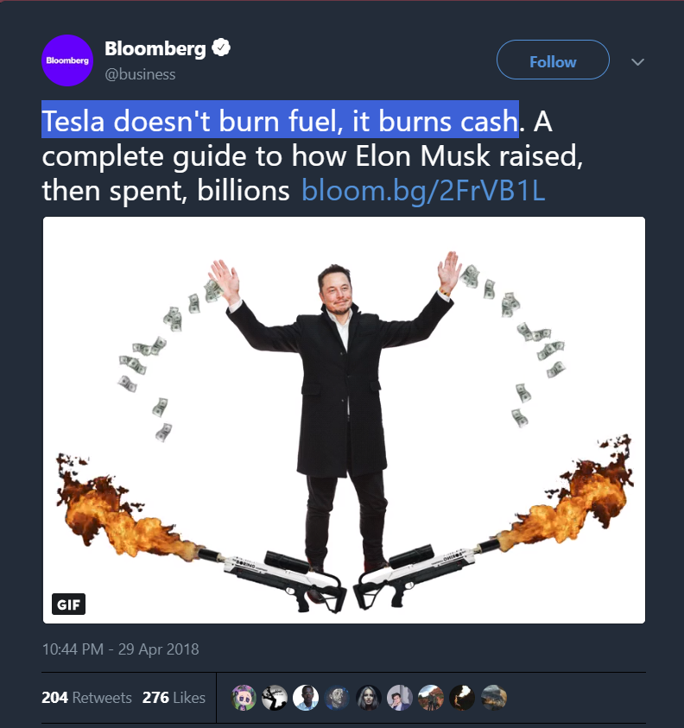
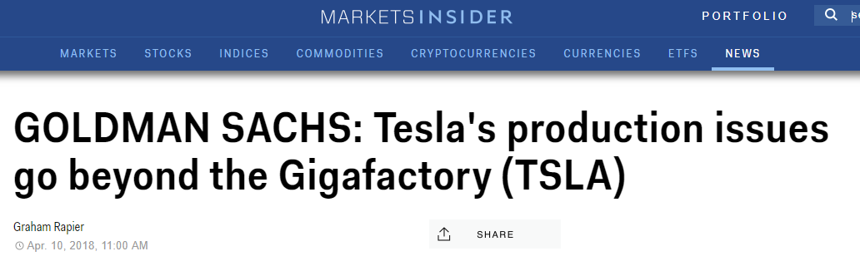
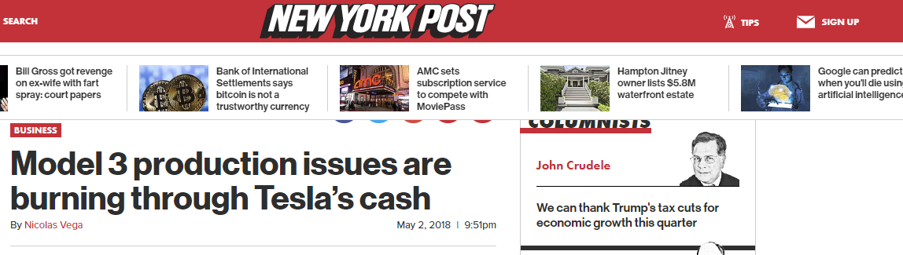
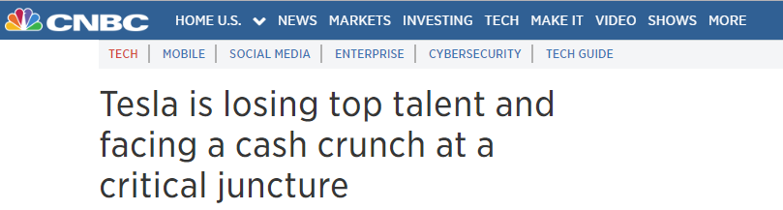

Slide 3
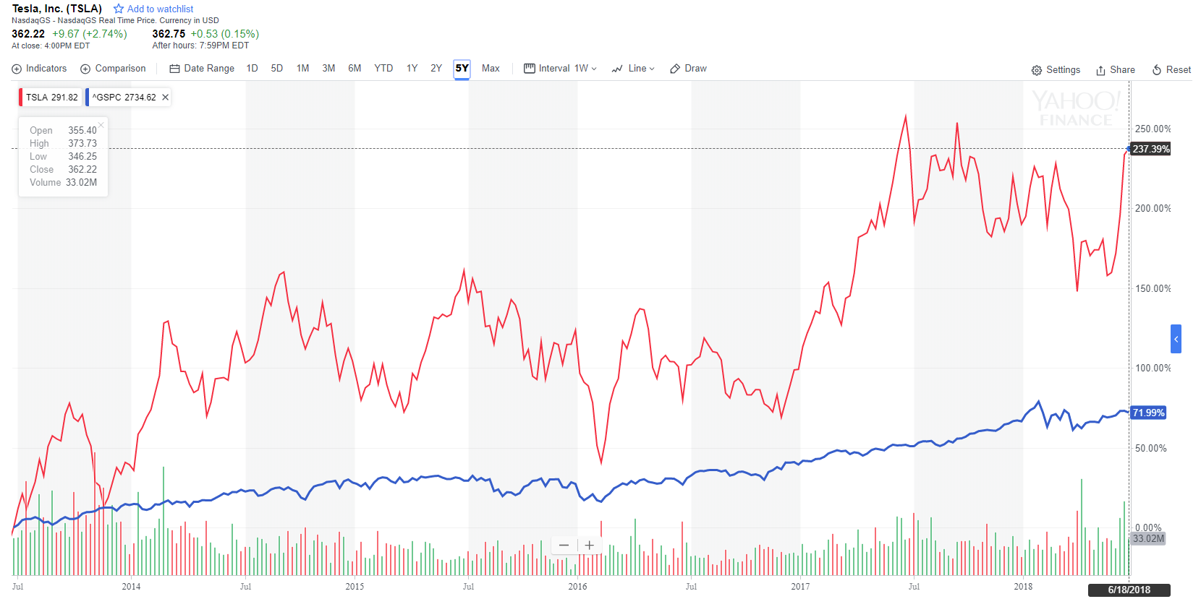



Slide 4
Our Data Sources:
Financial Statements (SEC 10-Q Filings)
Yahoo Finance
Twitter & Zacks.com

Slide 5
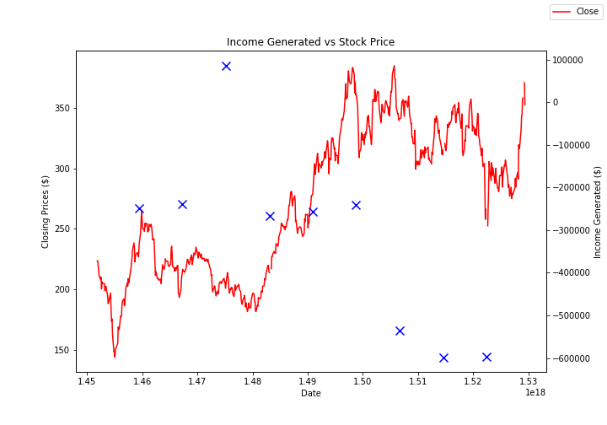

Market Reaction to Earnings (Financials):
Operating Income:
Cash Flows from Operations:

Slide 6
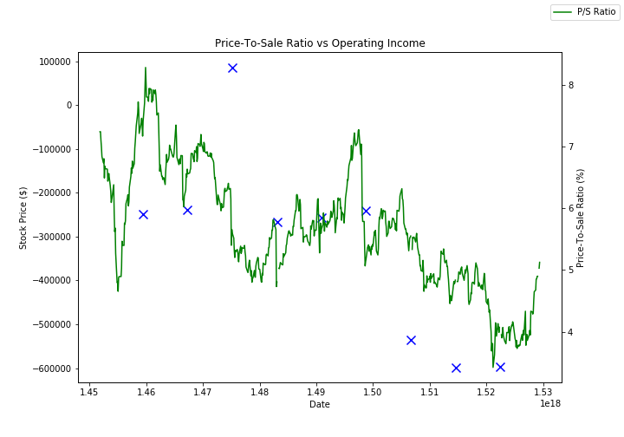
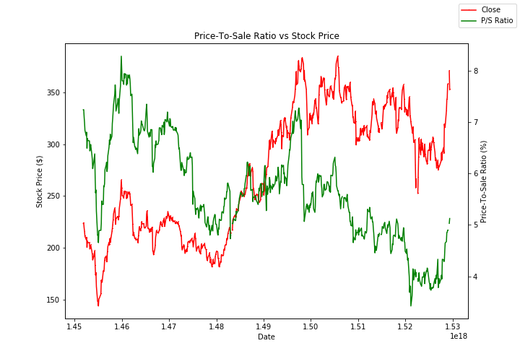
Price/Sale Ratio Against:
Operating Income:
Stock Market Price:

Slide 7
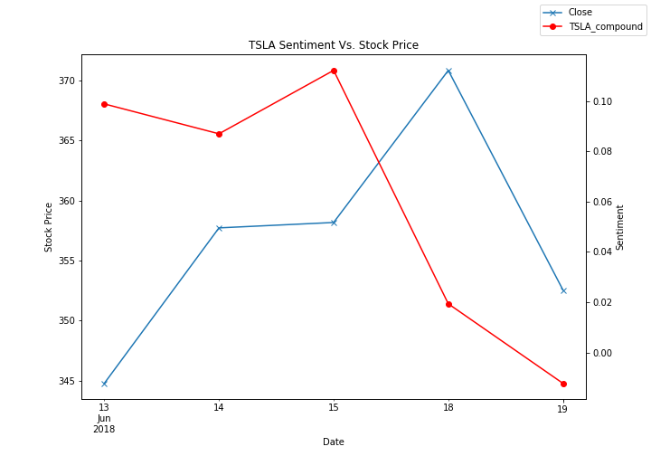
TSLA Sentiment vs Stock Price

Slide 8
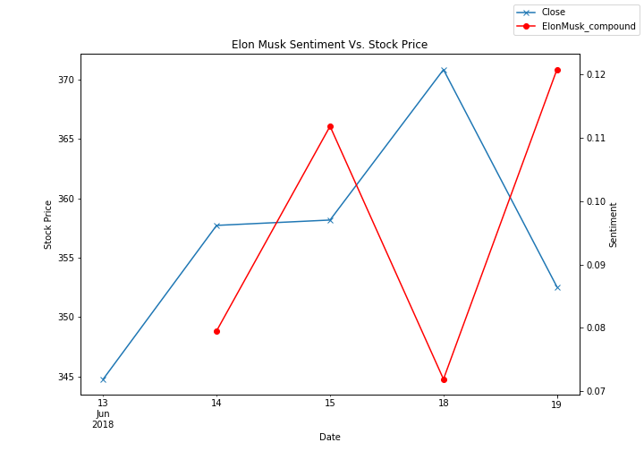
Elon Musk Sentiment vs Stock Price

Slide 9
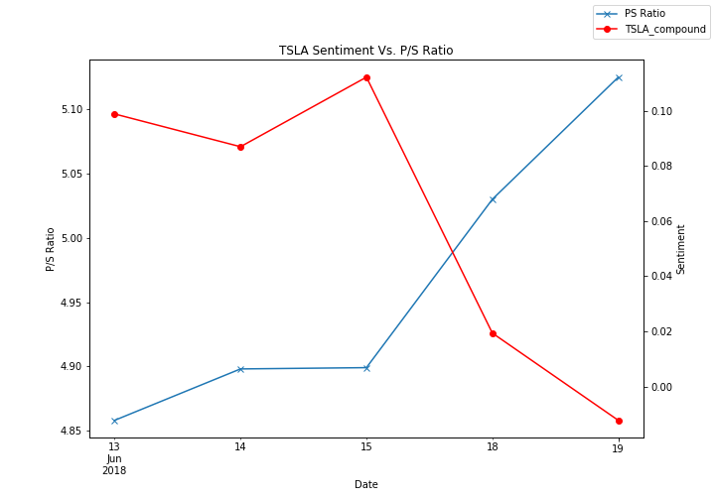
TSLA Sentiment vs Price per Sale Ratio

Slide 10
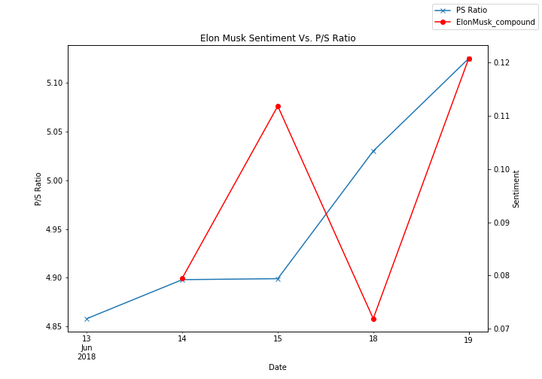
Elon Musk Sentiment vs Price per Sale Ratio

Slide 11
Lessons Learned
Historical twitter data is not easily accessible without a paid license
GMT to PST date conversion
Merging multiple data sources
Plotting with multiple y-axis
Working with various date formats
Understand your underlying data

Slide 12

Thank you!

Slide 16
Backup Slides (Do Not Use)

Slide 17

Financial Analysis: Key metrics
Operating Income:
Cash Flows from Operations:

